Slide 1

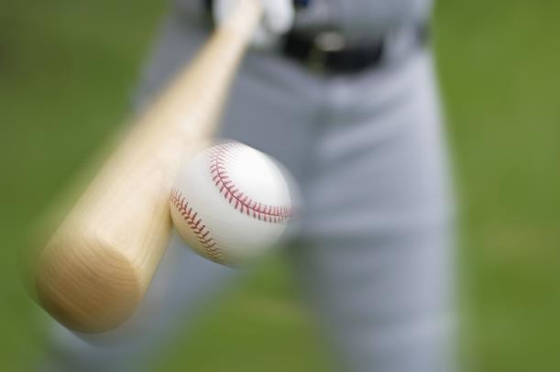
Project 2: Machine Learning Models and Predictive Analytics in Sports

Slide 2
Agenda
Introduction & Executive Summary
Modelling Basketball Outcomes
Modelling Baseball Outcomes
Conclusions

Slide 3
Introduction
Statistics and Predictions in Professional Sports
Fan Participation: Fantasy Leagues and Gambling
Two Demonstrations of Predictive Analytics:
Basketball
Baseball

Slide 4
EXECUTIVE SUMMARY
Baseball Predictive Results:
The Game Winner Can be predicted up to 95% accuracy by the end of the 8th Inning, and up to 80% Accuracy by the end of the 5th Inning.
Basketball Predictive Results:

Slide 5
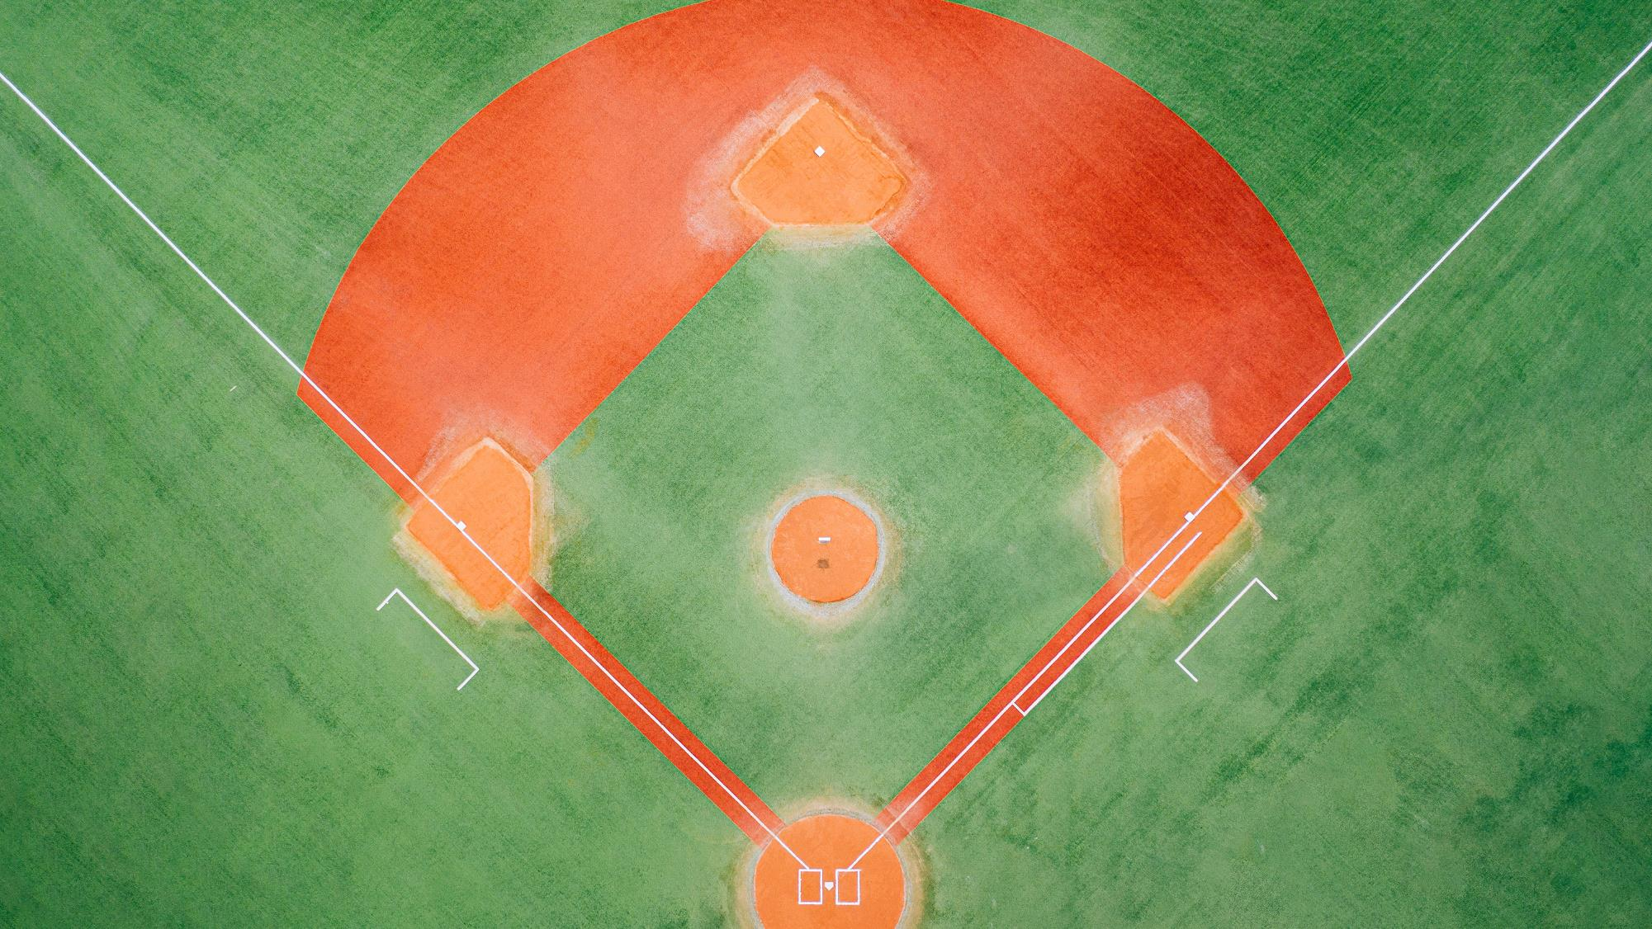
Baseball Predictive Model

Slide 6
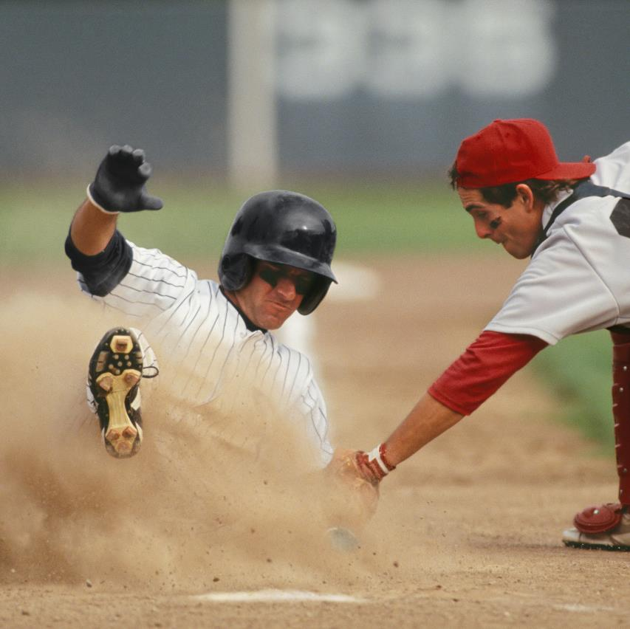
Baseball Problem: Who is going to win, in real-time, by inning?
Data Available: Game Outcomes
Scores by Inning
Can predictive models predict the outcome of a game prior to the 9th inning?
How early and with what accuracy can a predictive model predict the Outcome?

Slide 7
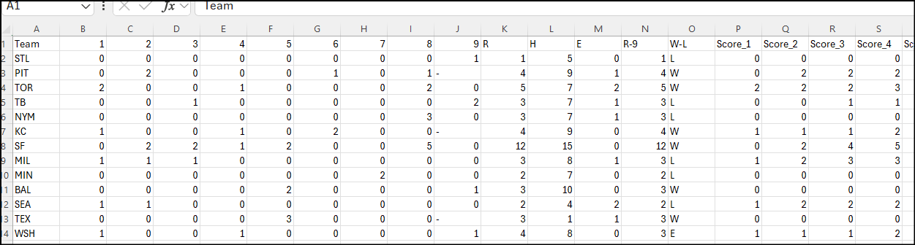

Data and Data Source
https://www.kaggle.com/datasets/josephvm/mlb-game-data Joseph Mohr
Start of 2016 season through end of the 2021 post-season.
Over 25,000 lines of data with Scores by Inning
Each Individual Row is one Team. Each pair of Lines are an Individual Game

Slide 8

Data Cleaning Summary
Discovered All-Star Games included in the Data.
Some Games were Cancelled Prior to 9 Innings
Some Games Had Extra Innings
Numbers were in both Integers and Strings
Final Data Set included Only Games that concluded in 9 innings.

Slide 9
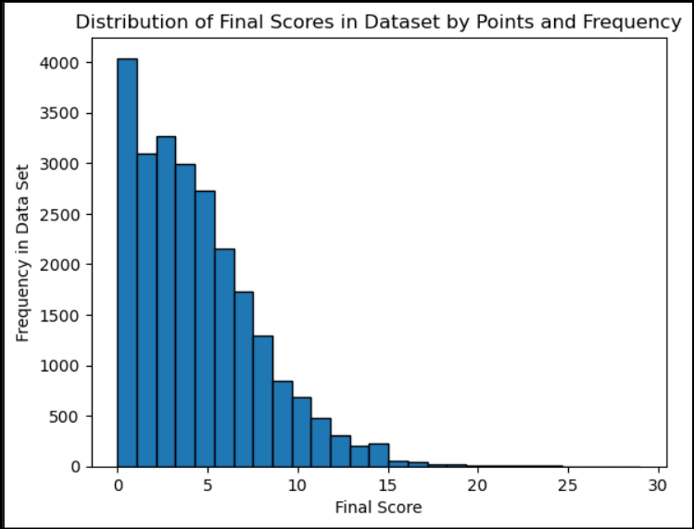
Data Cleaning Summary
Graphic Visualization of Test and Train Data
Scores are typically Low and Games are Close.
This is expected to impact the Ability to Predict Who Wins.

Slide 10
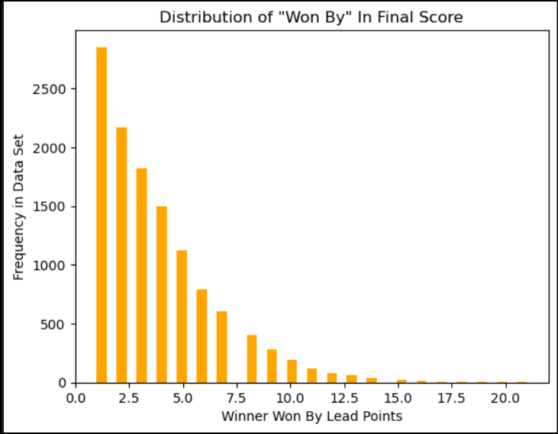
Data Cleaning Summary
Graphic Visualization of Test and Train Data
Scores are typically Low and Games are Close.
This is expected to impact the Ability to Predict Who Wins.

Slide 11
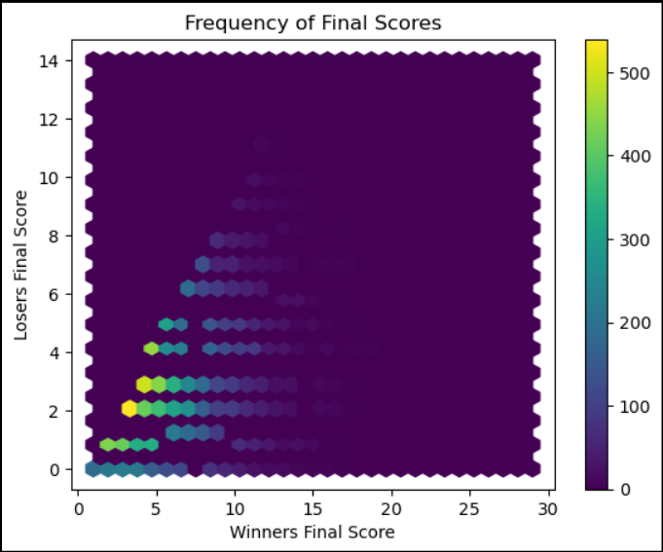
Data Cleaning Summary
Graphic Visualization of Test and Train Data
Scores are typically Low and Games are Close.
This is expected to impact the Ability to Predict Who Wins.

Slide 12
Primary Model Selection: Random Forest Model
Typically This is an Accurate Model, especially for data sets with multiple variables.
Variable: Runs per Inning
Score at end of Each inning
Score Lead
Final data Set varied from 2 columns (1st inning) to 44 Columns (9th Inning)

Slide 13

Testing Random Forest Model Application And Data With 9th Inning Results
With the Final Scores Available, Random Forest Model Correctly Predicted 100% Test and Train models as Expected

Slide 14
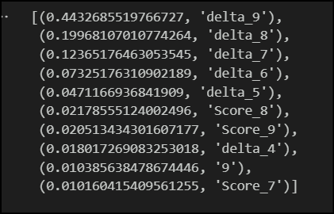
Testing Random Forest Model Application And Data With 9th Inning Results
Importances Indicated As Expected that the Lead from Inning to Inning was Most Impactful Variable.

Slide 15
Testing Random Forest Model Application: 1st through 8th Innings
Importances Indicated As Expected that the Lead from Inning to Inning was Most Impactful Variable.

Slide 16
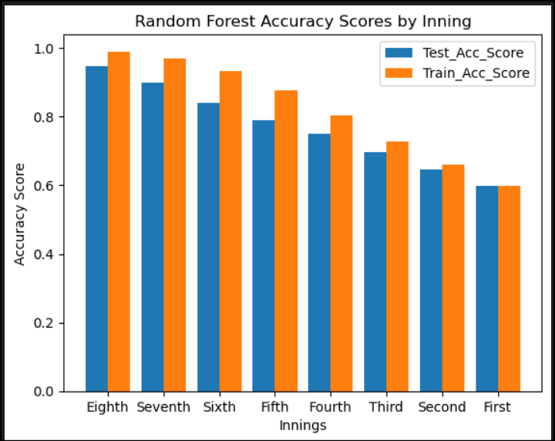
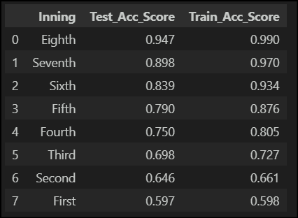
Results Random Forest Model Application: 1st through 8th Innings

Slide 17
Other Models First Inning (Similar Results)
Model | Train Accuracy | Test Accuracy
Random Forest | 60% | 60%
Logical Regression | 60% | 60%
Support Vector Machine | 60% | 60%
KNN Model | 54% | 55%
Decision Tree Classifier | 60% | 60%

Slide 18
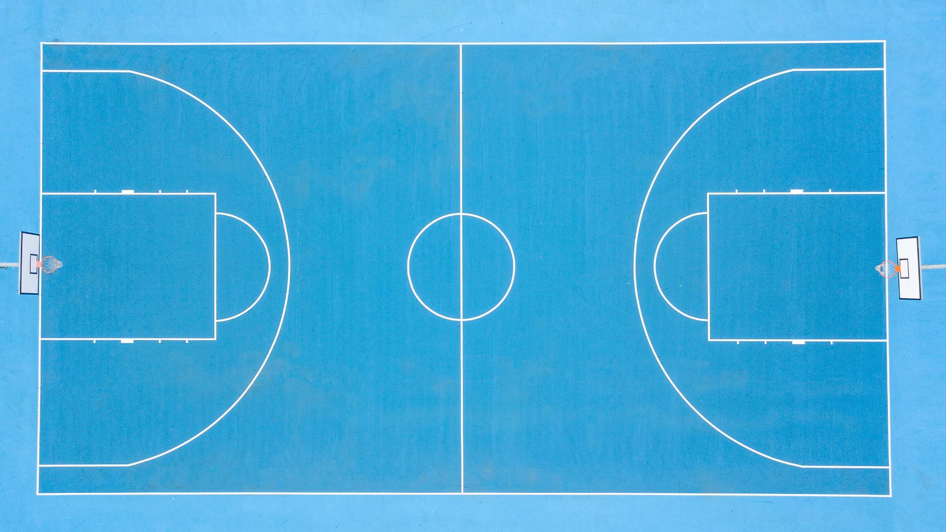
Basketball Predictive Model

Slide 19
NBA ANALYTICS BACKGROUND
There has been a revolution in the past 10 years in basketball as to how teams play and evaluate players
Shooting has been placed at a premium i.e. Steph Curry
“Shoot a Three or Get a Layup”, “Spacing”, “Pts PER Possession”
Players are evaluated through an analytics framework – shooting, defense and taking care of the Ball

Slide 20
What does this project do?
Attempted to identify the primary drivers to winning margin and which team wins
Does this by:
Converting metrics in the dataset to the advanced analytics data
Data Cleaning – use only data from 2004
Kmeans and PCA Analysis
Apply Linear Regression, Logistic Regression and Random Forest Classifier to identify the metrics that are the Key Drivers

Slide 21
Data preparation
Found a dataset on Kaggle that contains data for every NBA game since 1946
Only use data from 2004 – the year the NBA took its current form
Remove All-Star Games and Pre-Season Games
Create 2 Data frames – one for Playoff Games and one for In-Season
Advanced Data Metrics:
Calculate these metrics:
True Shooting Percentage: Total Points /((2* 2PT FGA) + (3PT FGA) +.44*FTA))
Assist To Turnover Ratio: Assist / Turn-Over
Rebound Margin: REB Home – REB - Visitor

Slide 22
analysis
KMEANS and PCA Analysis – I conducted it but did not use the smaller data sets
Linear Regression – made “Home Team Winning Margin” the Dependent Variable and True Shooting Percentage(TPS), Assist-To-Turnover Ration (A2O) and Rebound Margin as the Independent Variables
Logistic Regression – same as Linear Regression except the dependent variables was binary – 1 if the Home Team wins, 0 if they lose
Random Forest Classifier – Who Wins and Loses

Slide 23
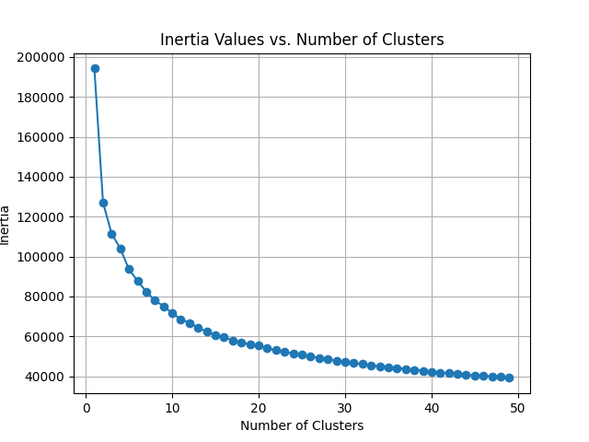
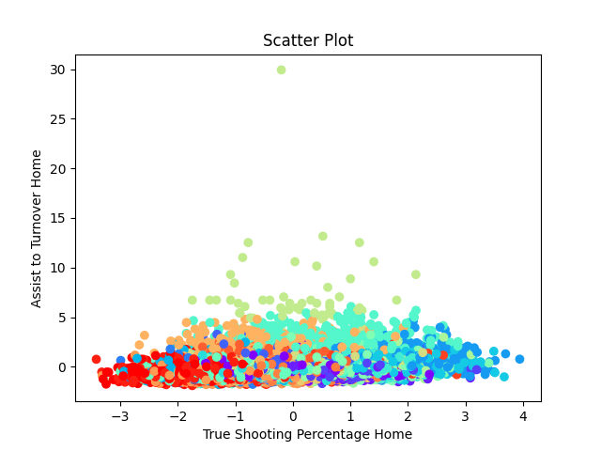
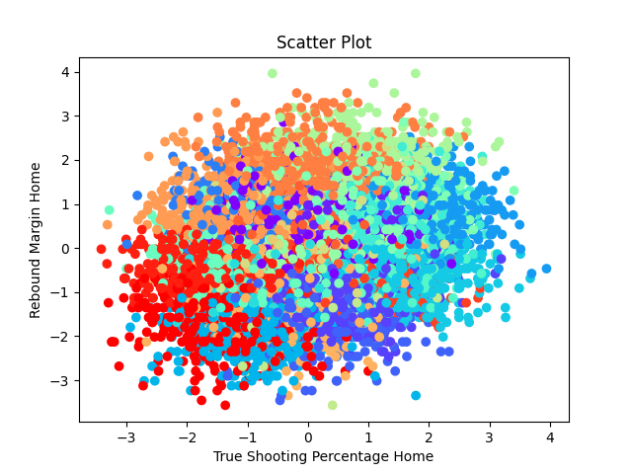
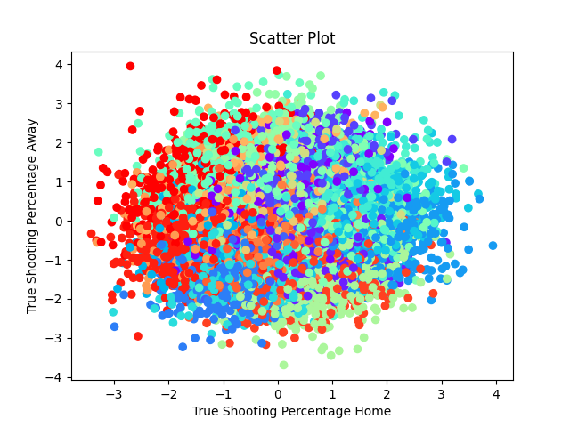
KMEANS ANALYSIS

Slide 24
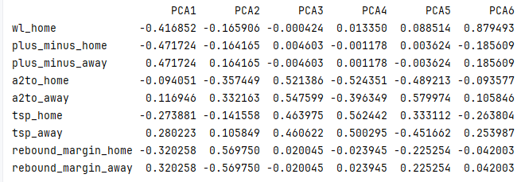
PCA ANALYSIS

Slide 25
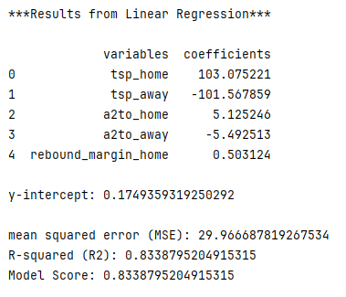
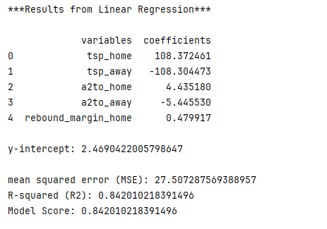
LINEAR REGRESSION
REGULAR SEASON
PLAYOFF

Slide 26
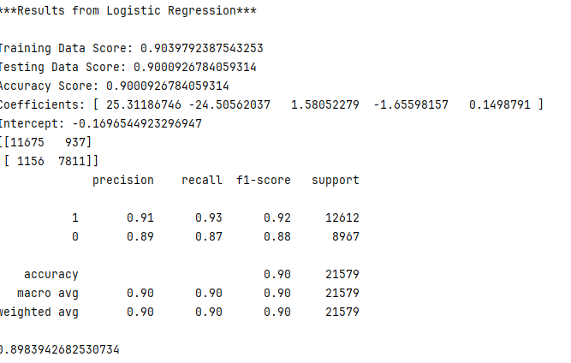
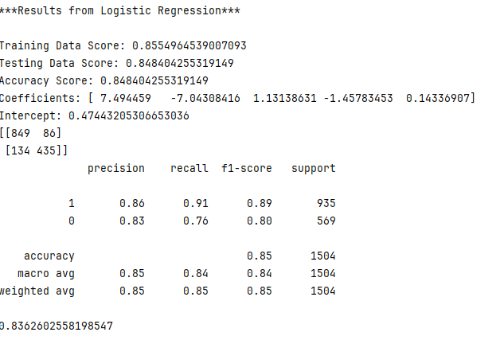
LOGISTIC REGRESSION
REGULAR SEASON
PLAYOFF

Slide 27
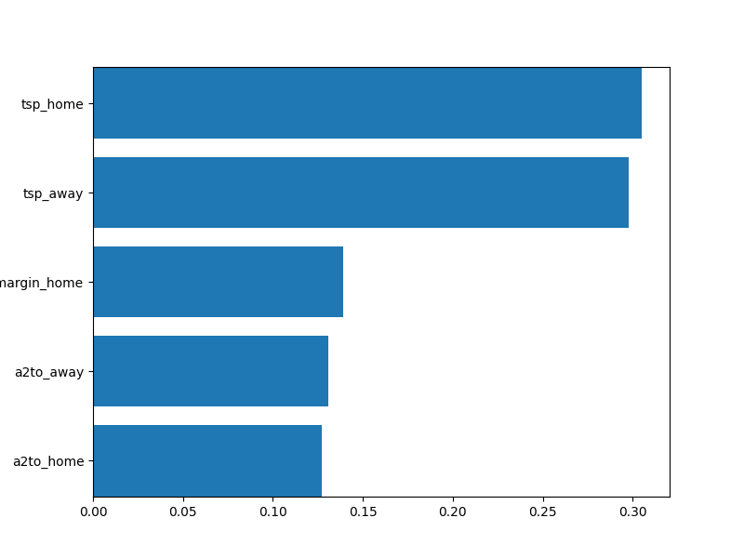
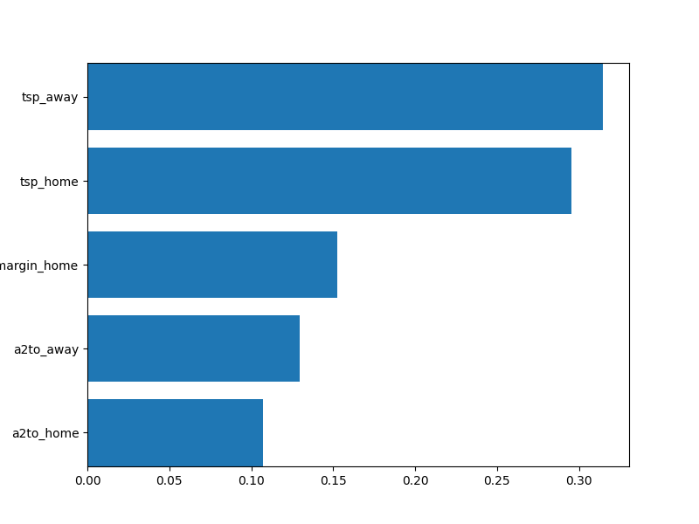
Random Forest Clasifier
REGULAR SEASON
PLAYOFF

